Slide 1

Vidyalankar Polytechnic
Program: Electronics and Telecommunication Engineering

Slide 2
Swarm Robots
Sania Bandekar - 17201B0022
Guided By:
Er. Anjum Mujawar

Slide 3
Abstract
Biomimicry.
Running parallel to the same, swarm intelligence emerged
It is based on the use of local rules, and simple robots compared to the complexity of the task to achieve.
Within a year, Beni had coined and popularized the term “swarm intelligence” in relation to robotics.
But if it was to argue about it’s application in military defense, then it would be-“The fiercest serpent may be overcome by a swarm of ants.”

Slide 4
Introduction
A swarm robot consists of an obstacle avoider robot along with a blind slave which mimics the master using the principles of communication. The transmission and reception modules help in coordinated movement inspired from nature.when a threat is pose to the master along with the slave, the direction of the bots is changed.
Features we are trying to introduce in swarm robots
Threat prediction model using data science
Mimicking capabilities
Obstacle avoiding ability
Proximity being independent of the functionality

Slide 5
Problem Statement
To create character bots for theatre purposes

Slide 6
Obstacle Avoider Master
Block Diagram
Battery (9v)
Battery (9v)
Blind Slave
VoltageRegulator
IC 7805
Voltage Regulator
IC 7805
Microcontroller
AT89S52
Microcontroller
AT89S52
Port 1
Port 2
Port3
Port 2
Port 0
Port 0
Port 1
Port 3
Comparator IC LM324
Motor Driver IC L293d
4 Bit RF Rx
4 Bit RF Tx
Free to use
IR Sensors
Antenna(signal)
Receiver’s side
Free to use
Antenna(signal)Transmitter’s side
DC Motors

Slide 7
Hardware and Software Implementation
Hardware Software
Battery Keil
Voltage Regulator IC 7805
Microcontroller AT89S52
4 Bit RF Tx and 4 Bit RF Rx
Comparator IC LM324
Motor driver L293d
Antenna(transmitter and receiver’s end)

Slide 8
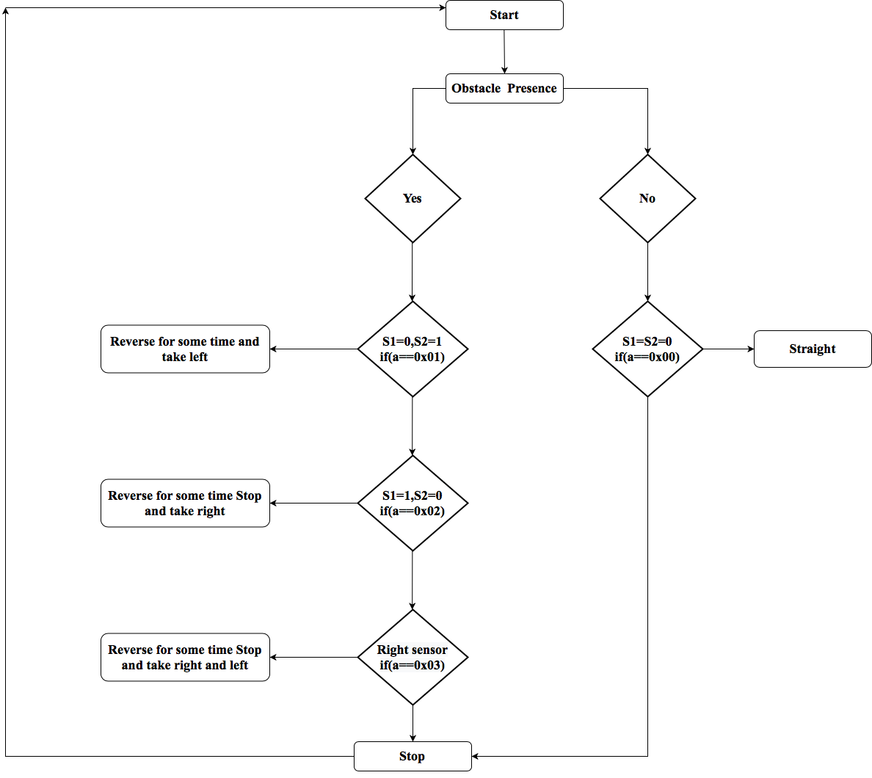
Flowchart
Master
Slave

Slide 9
Algorithm
Master
Start
If a==0x03meaning when obstacle is present at the front of both sensors(S1=1,S2=1), the robot should reverse for a while, stop then turn either left or right.The master vehicle will continue to follow the command and direction unless another input is detected by the sensors.
If a==0x01meaning when obstacle is present in the front of the right sensor(S1=0,S2=1), the robot should reverse for a while, stop and then turn left.The master will continue to follow the command and direction unless another input is detected by the sensors.
If a==0x02meaning when obstacle is present in the front of the left sensor(S1=1,S2=0), the robot should reverse for a while, stop and then turn right.The master will continue to follow the command and direction unless another input is detected by the sensors.
If a==0x00meaning when no obstacle is present in the front of both the sensors(S1=0,S2=0), the robot should continue moving straight.The master will continue to follow the command and direction unless another input is detected by the sensors.
Slave
Start
If a==0x0a meaning this motor input causes straight movement of the bot.The slave vehicle will continue to follow the command and direction unless another input is changed by the motor rotation.
If a==0x06 meaning this motor input causes left movement of the bot.The slave vehicle will continue to follow the command and direction unless another input is changed by the motor rotation.
If a==0x00 meaning this motor input causes stop the bot to stop.The slave vehicle will continue to follow the command and direction unless another input is changed by the motor rotation.
If a==0x09 meaning this motor input causes right movement of the bot.The slave vehicle will continue to follow the command and direction unless another input is changed by the motor rotation.
If a==0x05 meaning this motor input causes reverse movement of the bot.The slave vehicle will continue to follow the command and direction unless another input is changed by the motor rotation.

Slide 10
Pros and Cons
Advantages
Robustness
Flexibility
Scalability
Lifetime of swarm is large
Can accomplish a goal together
Few homogeneous groups
Local sensing
Decentralized
Coordinating
Parallelism
Economical
Stable
Limitations
Security issues ,Identification and authentication
Externalities
Human interaction is not possible
Adding new robots means changing the communication and the control systems.

Slide 11
Applications
Provides user friendly communication
Personal assistance for the disabled
Interactive and informative for the young ones
Creates bonding in fields where audience gets engaged with stage dramatics and theatre education
Is used in sci-fi based movies

Slide 12
Conclusion
As swarm robotics have lot of features but still it is not widely acceptable to solve the real life problems. Further research is needed on robotic hardware to overcome hardware shortcomings that limit the functionality of current robotic systems. Central control limits the functionality of swarm robotics but there can be a robot among swarm which has the capability of sensing and repairing hardware defect of other robots and also has leadership quality to control and guide distributed autonomous robots in desirable situation. Further research on behavioral control is needed to discover effective ways to let a human operator interact with a robot swarm. Indirect communication might get enhanced in future. In the remote location and for the outhouse applications, to charge battery solar energy might become feasible in near future.

Slide 13
Output Screenshots

